Slide 1
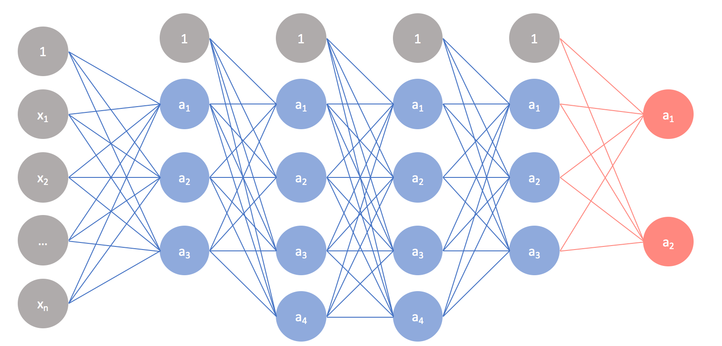
System Architecture Batch -03
Input
Feature Extraction
CNN Module
Classification
Evaluation
CASIA_MFSD Dataset
Training dataset
Frame capture
BPCER
Principal Component Analysis (PCA)
Live video
Haar cascade (256x256)
Pooling layer
APCER
CNN (3 Layers)
Support Vector Machine (SVM)
Deep face extraction
ReLU
ACER

